Slide 1

A
Major Project
On
DEEP FACIAL DIAGNOSIS DEEP TRANSFER LEARNING FROM FACE RECOGNITION TO FACIAL DIAGNOSIS
(Submitted in partial fulfillment of the requirements for the award of Degree)
BACHELOR OF TECHNOLOGY
In
COMPUTER SCIENCE AND ENGINEERING
By
AVIRINENI RAHUL (197R1A05C6)
BOINI LAXMI VARA PRASAD (197R1A05D1)
JANGILI SHIVA PRANAV (197R1A05E1)
Under the Guidance of
DR.K. MAHESWARI
(Associate Professor)
DEPARTMENT OF COMPUTER SCIENCE AND ENGINEERING
CMR TECHNICAL CAMPUS UGC AUTONOMOUS
(Accredited by NAAC, NBA, Permanently Affiliated to JNTUH, Approved by AICTE, New Delhi) Recognized Under Section 2(f) & 12(B) of the UGCAct.1956, Kandlakoya (V), Medchal Road, Hyderabad-501401.
2019-2023

Slide 2
ABSTRACT
The objective here is to explore the possibility of identifying diseases from uncontrolled 2D face images by deep learning techniques.
In the deep transfer learning from face recognition to perform the computer-aided facial diagnosis on various diseases. In the experiments, we perform the computer-aided facial diagnosis on single (beta-thalassemia) and multiple diseases (beta-thalassemia, hyperthyroidism, Down syndrome, and leprosy) with a relatively small dataset.
The overall top-1 accuracy by deep transfer learning from face recognition can reach over 94% which outperforms the performance of both traditional machine learning methods and clinicians in the experiments.
The success of deep transfer learning applications in the facial diagnosis with a small dataset could provide a low-cost and noninvasive way for disease screening and detection.

Slide 3
Introduction
Facial diagnosis is an important and very intuitive diagnostic method. The facial diagnosis refers to that practitioners perform disease diagnosis by observing facial features. The shortcoming of facial diagnosis is that for getting a high accuracy facial diagnosis requires doctors to have a large amount of practical experience.
It is still difficult for people to take a medical examination in many rural and underdeveloped areas because of the limited medical resources, which leads to delays in treatment in many cases. Even in metropolises, limitations including the high cost, long queuing time in hospital and the doctor-patient contradiction which leads to medical disputes still exist.
Computer-aided facial diagnosis enables us to carry out non-invasive screening and detection of diseases quickly and easily. Therefore, if facial diagnosis can be proved effective with an acceptable error rate, it will be with great potential. With the help of artificial intelligence, we could explore the relationship between face and disease with a quantitative approach.
Notes:
3

Slide 4
Existed System
Due to the scarcity of medical resources, it is still challenging for people to get a medical exam today in many rural and undeveloped areas, which frequently causes treatment to be delayed. Limitations still exist, such as high costs, lengthy hospital wait times, and doctor-patient conflicts that result in medical disputes, even in major cities. We can rapidly and easily do non-invasive screening and disease detection thanks to computer-aided face diagnostics. Therefore, facial diagnosis will have significant promise if it can be demonstrated to be effective with a tolerable error rate. We could use artificial intelligence to study the correlation between sickness and face using a quantitative method.
DISADVANTAGES :
high costs
lengthy hospital wait times
doctor-patient conflicts that result in medical disputes
Notes:
4

Slide 5
PROPOSED SYSTEM:
In this deep learning algorithm to detect disease from facial diagnosis as now-a-days due to so many diseases all hospitals are full which will not permit to see doctor sooner and this result into late diagnosis and to avoid such problem author is building neural network to predict disease from computer. Author is saying to train algorithm with small dataset will not give better prediction result so author is performing transfer learning with prebuilt VGG16 neural network.
In this transfer learning we can use any prebuilt neural network and then embed our own dataset training in the last layer of that prebuilt CNN algorithm. This algorithm model can give better prediction result.
ADVANTAGES :
The success of deep transfer learning applications in the facial diagnosis with a small dataset could provide a low-cost and noninvasive way for disease screening and detection.
We hope that more and more diseases can be detected efficiently by face photographs.

Slide 6
SYSTEM REQUIREMENTS
HARDWARE REQUIREMENTS :
Minimum hardware requirements are very dependent on the particular software being developed by a given Enthought Python / Canopy / VS Code user. Applications that need to store large arrays/objects in memory will require more RAM, whereas applications that need to perform numerous calculations or tasks more quickly will require a faster processor.
Operating system : windows, linux
Processor : minimum intel i3
Ram : minimum 4 gb
Hard disk : minimum 250gb

Slide 7
SOFTWARE REQUIREMENTS :
The functional requirements or the overall description documents include the product perspective and features, operating system and operating environment, graphics requirements, design constraints and user documentation.
The appropriation of requirements and implementation constraints gives the general overview of the project in regards to what the areas of strength and deficit are and how to tackle them.
Python idel 3.7 version (or)
Anaconda 3.7 ( or)
Jupiter (or)
Google colab

Slide 8
NOVELTY
In this deep transfer learning from face recognition to perform the computer-aided facial diagnosis on various diseases. Our goal is to detect and recognize disease like Beta-thalassemia, Hyperthyroidism, vitiligo and Leprosy using facial image of the peopel. In this application we will implement transfer learning based deep learning models like VGG16 and CNN model. At the same time we compare these models performance.

Slide 9
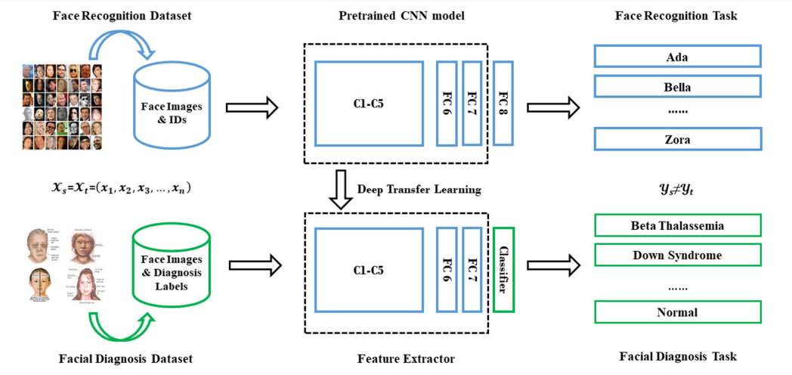
Architecture

Slide 10
Modules
Upload Facial Diagnosis Dataset
Preprocess Dataset
Model Generation
Fine Tune VGG16 Transfer Learning
Accuracy & Loss Graph
Upload Test Image & Predict Disease

Slide 11
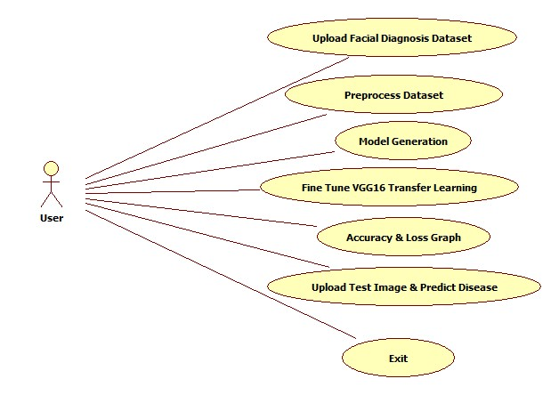
UML Diagrams
Use case Diagram

Slide 12
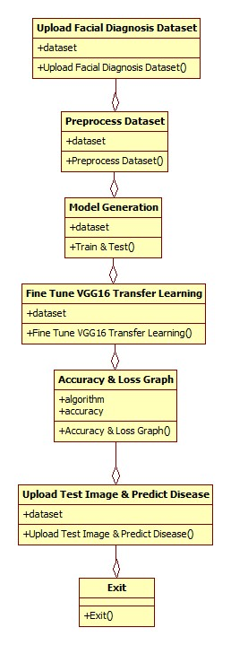
UML Diagrams
Class Diagram

Slide 13
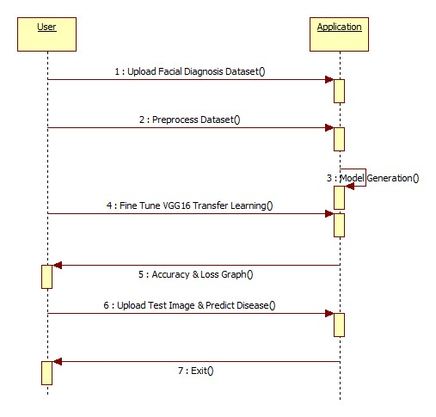
UML Diagrams
Sequence Diagram

Slide 14
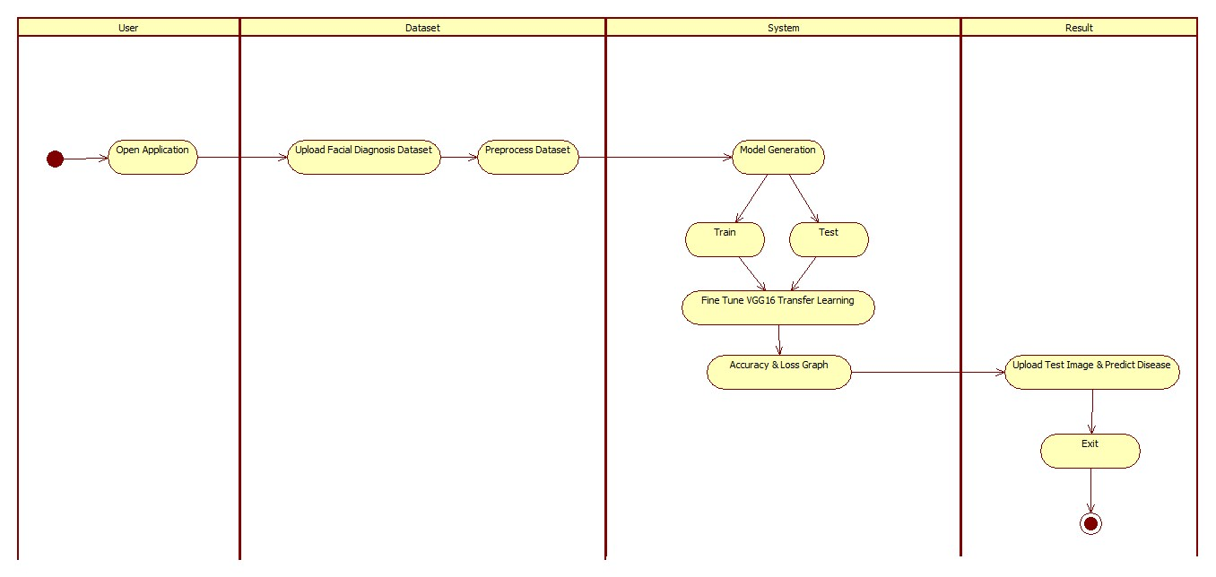
UML Diagrams
Activity Diagram

Slide 15
Sample code
from matplotlib import pyplot as plt
from tkinter import messagebox
from tkinter import *
from tkinter import filedialog
from keras import applications
from keras.layers import Input
import os
from keras.preprocessing import image
import numpy as np
from keras.layers import Convolution2D
import cv2
import imutils
import pickle root = tkinter.Tk() root.title("Deep Facial Diagnosis: Deep Transfer Learning From Face
Recognition to Facial Diagnosis")
root.geometry("1200x850")
global filename
global vgg_classifier
global training_set
global test_set

Slide 16
classes = ['Beta-Thalassemia','Down syndrome','Hyperthyroidism','Leprosy']
def upload():
global filename
filename = filedialog.askdirectory(initialdir=".")
text.delete('1.0', END)
text.insert(END,filename+" loaded\n");
def preprocess():
text.delete('1.0', END)
global training_set
global test_set
train_datagen = ImageDataGenerator()
test_datagen = ImageDataGenerator()
training_set = train_datagen.flow_from_directory('Dataset/train',target_size = (224, 224), batch_size = 2, class_mode = 'categorical', shuffle=True)
test_set = test_datagen.flow_from_directory('Dataset/test',target_size = (224, 224), batch_size = 2, class_mode = 'categorical', shuffle=False)
text.insert(END,"Dataset preprocessing completed\n")
text.insert(END,"Total classes found in dataset : "+str(training_set.class_indices)+"\n")

Slide 17
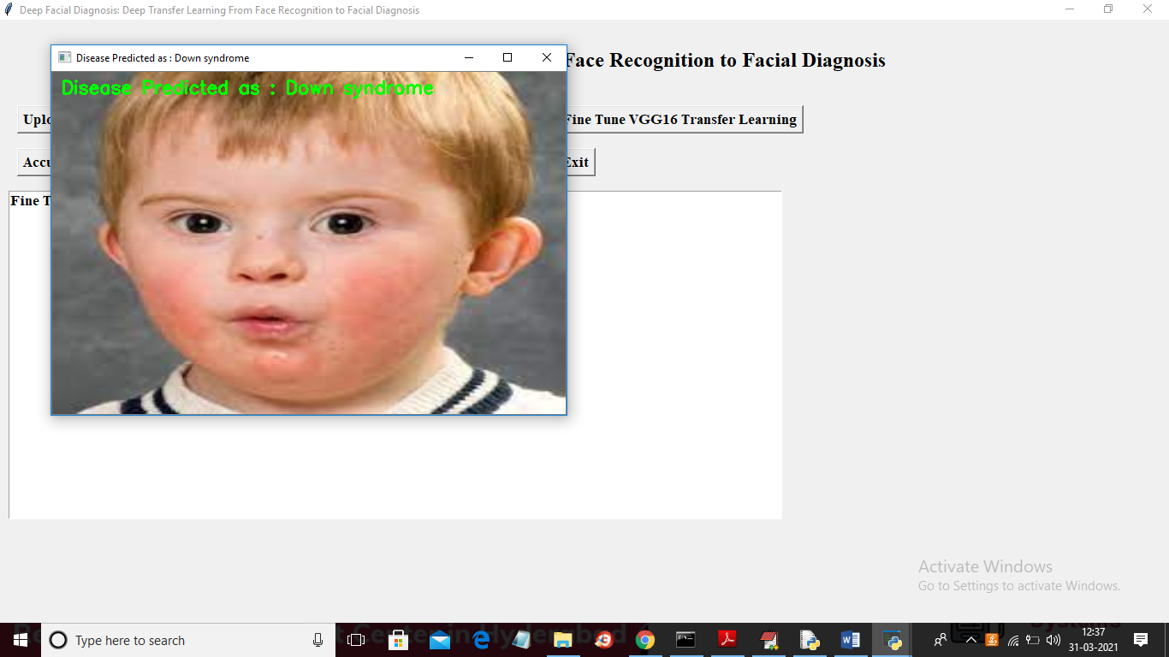
Result

Slide 18
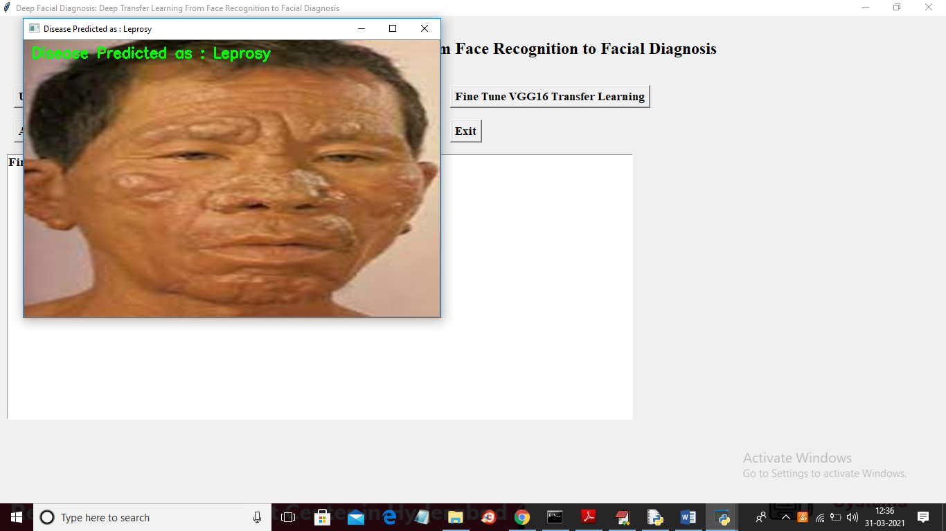

Slide 19
CONCLUSION
More and more studies have shown that computer-aided facial diagnosis is a promising way for disease screening and detection. In this paper, we propose deep transfer learning from face recognition methods to realize computer-aided facial diagnosis definitely and validate them on single disease and various diseases with the healthy control. The experimental results of above 94% accuracy have proven that CNN as a feature extractor is the most appropriate deep transfer learning method in the case of the small dataset of facial diagnosis. It can solve the general problem of insufficient data in the facial diagnosis area to a certain extent. In future, we will continue to discover deep learning models to perform facial diagnosis effectively with the help of data augmentation methods. We hope that more and more diseases can be detected efficiently by face photographs.

Slide 20
Thank You!

